Slide 1
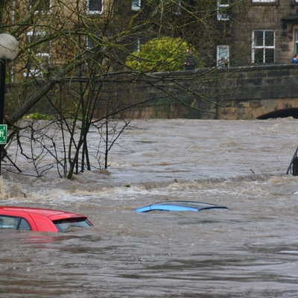
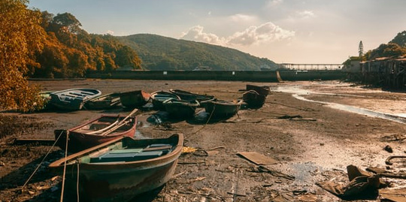
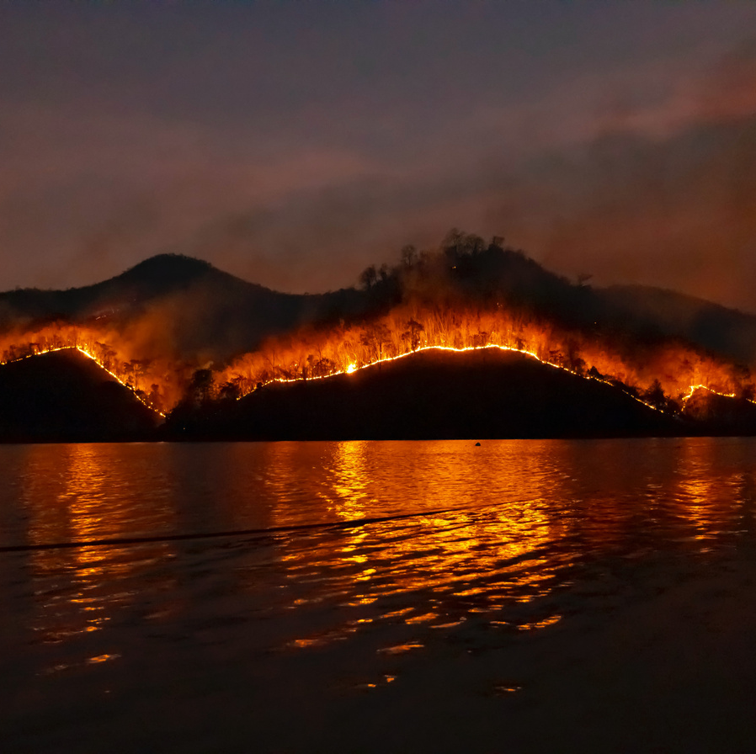
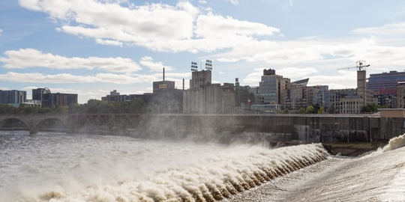
AWRA 2022 Spring Conference
Water Risk Under a
Rapidly Changing World - Evaluation & Adaptation
April 25-27
Tuscaloosa, AL
USA
#AWRA2022
awra.org

Slide 2
2022 Spring Conference
[INSERT SESSION TITLE]
[INSERT SESSION NUMBER]
PRESENTERS: [Insert presenter information]
All rights reserved. No part of this presentation, publication, research or materials may be reproduced, distributed, or transmitted in any form or by any means, including photocopying, recording, or other electronic or mechanical methods, without the prior written permission of the author(s).

Slide 3
Thank you for participating!
Contact us with questions:
Presenters: [Insert presenter names and contact information]
All rights reserved. No part of this presentation, publication, research or materials may be reproduced, distributed, or transmitted in any form or by any means, including photocopying, recording, or other electronic or mechanical methods, without the prior written permission of the author(s).

